Slide 1


Deep Dive into HashiCorp Vault
This presentation explores HashiCorp Vault, a tool for managing secrets. We will cover its core functionalities and best practices.
by Vidhya Sudarsanan

Slide 2

Understanding Secret Engines
Secret Engine
Purpose
KV
Key/Value storage of static secrets
AWS
Dynamic AWS IAM credentials
Database
Dynamic DB usernames/passwords
Transit
Encryption as a service
PKI
Issue and manage TLS certificates
SSH
One-time SSH credentials
Secret engines are components within Vault that store, generate, or encrypt data. Each engine serves a specific purpose for managing diverse secret types.

Slide 3
The KV Secrets Engine
KV Engine Overview
Use Cases
The Key/Value (KV) engine stores static secrets. It handles passwords, API keys, and tokens. Secrets are stored as key-value pairs.
Application configuration secrets
CI/CD tokens for automation
TLS certificates and license keys
Think of KV as a secure, version-controlled key-value store. It provides a robust solution for static secret management.

Slide 4

KV v1 vs. KV v2
Feature
KV v1
KV v2
Versioning
❌ No
✅ Yes
Metadata support
❌ No
✅ Yes
Rollback
❌ No
✅ Retrieve older versions
API endpoints
/secret/
/secret/data/
KV v2 offers significant enhancements over v1, including crucial versioning and metadata capabilities. It is the recommended version for all new deployments.

Slide 5





Enabling and Using KV v2
Enable KV v2
Use
vault secrets enable -path=secret kv-v2
Versioning
KV v2 automatically tracks changes to secret data.
Rollback
Retrieve older versions with
vault kv get -version=2 secret/myapp
Metadata
Manage secret lifecycle and audit trails using metadata.
KV v2 provides powerful features for robust secret management. Versioning and rollback are critical for compliance and security.

Slide 6

Path Conventions and Best Practices
Path Naming
Isolation
Use consistent prefixes (e.g., secret/dev/appname).
Avoid root-level secret storage.
Separate by environment: secret/dev/, secret/prod/.
Use namespaces or folders to isolate access.
Security
Regularly rotate and audit all secrets.
Implement policies to restrict path access.
Effective path management enhances security and maintainability. Consistent naming and strict access controls are vital.

Slide 7





Audit Logs and Access Control
Why Audit?
Track all secret access. Essential for compliance and security.
Enable Logging
Use
vault audit enable file file_path=/var/log/vault_audit.log
Log Details
Timestamp, auth method, HTTP method, policy matched. Logs are unstructured JSON.
Parsing
Use tools like jq for efficient parsing.
Robust audit logging is fundamental for security investigations and regulatory compliance. Detailed logs provide insights into access patterns.

Slide 8
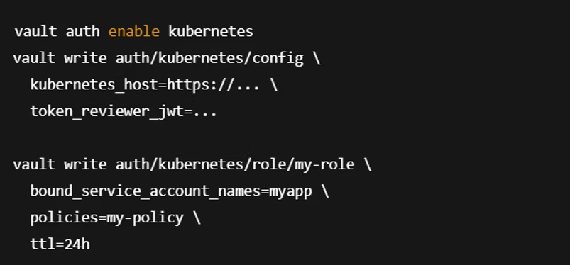
Vault with Docker and Kubernetes
Docker Use Cases
Kubernetes Integration
Local testing with dev mode
Inject secrets via Vault Agent Sidecar
Running Vault agent in containers
Authenticate pods via Kubernetes auth method
Vault seamlessly integrates with containerized environments. Helm charts, sidecar, and CSI driver support simplify deployment and secret injection.

